Slide 1

Face Mask Detection Using Deep Learning Dt:
Batch - Number
XXX (XX)
XXXX (xxx)
Under the guidance of
Mr. XXXX
Assistant Professor

Slide 2
CONTENTS
ABSTRACT
LITERATURE SURVEY
INTRODUCTION
PROBLEM STATEMENT
EXISTING SYSTEM WITH DRAWBACKS
PROPOSED SYSTEM WITH ADVANTAGES
SYSTEM REQUIREMENTS
MODULES DESCRIPTION
DESIGN MODELS
UML DIAGRAMS
IMPLEMENTATION
TECHNOLOGIES
TESTING
RESULTS
CONCLUSION
FUTURE ENHANCEMENTS
REFERENCES
BIBLIOGRAPHY

Slide 3
ABSTRACT
In order to prevent the spread of CORONA virus, everyone must wear a mask during the pandemic. In these tough times of COVID-19 it is necessary to build a model that detects people with and without mask in real-time as it works as a simple precautionary measure to prevent the spread of virus. If deployed correctly, this machine learning technique helps in simplifying the work of frontline warriors and saving their lives.
A basic Convolutional Neural Network (CNN) model is built using TensorFlow, Keras, Scikit-learn and OpenCV to make the algorithm as accurate as possible.
Javascript API helps in accessing webcam for real-time face mask detection. Since Google Colab runs on web browser it can’t access local hardware like a camera without APIs.
The proposed work contains three stages: (i) pre-processing, (ii) Training a CNN and (iii) Real-time classification. The first part is the Pre-processing section, which can be divided into “Grayscale Conversion” of RGB image, ”image resizing and normalization” to avoid false predictions.
Then the proposed CNN, classifies faces with and without masks as the output layer of proposed CNN architecture contains two neurons with Softmax activation to classify the same.
Categorical cross-entropy is employed as loss function.
The proposed model has Validation accuracy of 96%. If anyone in the video stream is not wearing a protective mask a Red coloured rectangle is drawn around the face with a dialog entitled as NO MASK and a Green coloured rectangle is drawn around the face of a person wearing MASK.

Slide 4
LITERATURE SURVEY
Detecting Masked Faces in the Wild with LLE-CNNs
AUTHORS: Shiming Ge,Jia Li,Qiting Ye,Zhao Luo
ABSTRACT:
Detecting faces with occlusions is a challenging task due to two main reasons:
1) The absence of large datasets of masked faces, and
2) The absence of facial cues from the masked regions. To address these two issues, this paper first introduces a dataset, denoted as MAFA, with 30, 811 Internet images and 35, 806 masked faces.
Faces in the dataset have various orientations and occlusion degrees, while at least one part of each face is occluded by mask. Based on this dataset, we further propose LLE-CNNs for masked face detection, which consist of three major modules.
The Proposal module first combines two pre-trained CNNs to extract candidate facial regions from the input image and represent them with high dimensional descriptors.
After that, the Embedding module is incorporated to turn such descriptors into a similarity-based descriptor by using locally linear embedding (LLE) algorithm and the dictionaries trained on a large pool of synthesized normal faces, masked faces and non-faces.
In this manner, many missing facial cues can be largely recovered and the influences of noisy cues introduced by diversified masks can be greatly alleviated.
Finally, the Verification module is incorporated to identify candidate facial regions and refine their positions by jointly performing the classification and regression tasks within a unified CNN. Experimental results on the MAFA dataset show that the proposed approach remarkably outperforms 6 state-of-the-arts by at least 15.6%.

Slide 5
INTRODUCTION
Objective:
This paper proposes a method to detect the face mask is put on or not for offices, or any other work place with a lot of people coming to work. We have used convolutional neural network for the same.
The model is trained on a real world dataset and tested with live video streaming with a good accuracy.
Further the accuracy of the model with different hyper parameters and multiple people at different distance and location of the frame is done.
If anyone in the video stream is not wearing a protective mask and a Red colored rectangle is drawn around the face with a dialog entitled as NO MASK.
Similarly a Green color rectangle is drawn around the face of a person wearing MASK.

Slide 6
PROBLEM STATEMENT
Millions of people are being infected by Corona Virus throughout the world rapidly.
Even WHO recommends to wear a mask in public places to cut the spread of virus as it is contagious.
In this paper, a CNN model is proposed for face mask detection.
Object detection when applied on faces helps in detecting faces in the image.
Face mask detection refers to detecting faces in the image and then classifying each face as with mask or without mask.

Slide 7
EXISTING SYSTEM WITH DRAWBACKS
Government and Public health agencies are recommending face mask as essential measures to keep us safe when venturing into public.
To mandate the use of facemask, it becomes essential to devise some technique that enforce individuals to apply a mask before exposure to public places.
Face mask detection refers to detect whether a person is wearing a mask or not.
In fact, the problem is reverse engineering of face detection where the face is detected using different machine learning algorithms for the purpose of security, authentication and surveillance.
Face detection is a key area in the field of Computer Vision and Pattern Recognition. A significant body of research has contributed sophisticated to algorithms for face detection in past.
DRAWBACKS:
1.It is difficult to handle person to identify person with mask or without mask in surveillance.

Slide 8
PROPOSED SYSTEM WITH ADVANTAGES
The proposed CNN, classifies faces with and without masks as the output layer of proposed CNN architecture contains two neurons with Softmax activation to classify the same.
Categorical cross-entropy is employed as loss function.
The proposed model has Validation accuracy of 96%.
If anyone in the video stream is not wearing a protective mask a Red coloured rectangle is drawn around the face with a dialog entitled as NO MASK and a Green coloured rectangle is drawn around the face of a person wearing MASK.
ADVANTAGES:
1.The proposed model has Validation accuracy of 96%. If anyone in the video stream is not wearing a protective mask a Red coloured rectangle is drawn around the face with a dialog entitled as NO MASK and a Green coloured rectangle is drawn around the face of a person wearing MASK.

Slide 9
SYSTEM REQUIREMENTS
HARDWARE REQUIREMENTS :
System : Pentium IV 2.4 GHz.
Hard Disk : 40 GB.
Floppy Drive : 1.44 Mb.
Monitor : 15 VGA Colour.
Mouse : Logitech.
Ram : 512 Mb.
SOFTWARE REQUIREMENTS:
Operating System: Windows
Coding Language: Python 3.7

Slide 10
MODULES DESCRIPTION
Upload Dataset
In this module user upload dataset.
Build Deep Learning Classifier
In this module Deep learning classifier is build.
Build Training Module
In this module learning is train to detect mask.
Accuracy
In this module Accuracy of train model is shown.
Start Camera
In this module camera is started here.
Person Recognition
In this module person recognition takes place here.
Detection Mask Or Un Mask
In this module person is detected with mask or not.

Slide 11
DESIGN MODELS
The Unified Modeling Language is a standard language for specifying, Visualization, Constructing and documenting the artifacts of software system, as well as for business modeling and other non-software systems.
The UML represents a collection of best engineering practices that have proven successful in the modeling of large and complex systems.
The UML is a very important part of developing objects oriented software and the software development process. The UML uses mostly graphical notations to express the design of software projects.
GOALS:
The Primary goals in the design of the UML are as follows:
Provide users a ready-to-use, expressive visual modeling Language so that they can develop and exchange meaningful models.
Provide extendibility and specialization mechanisms to extend the core concepts.
Be independent of particular programming languages and development process.
Provide a formal basis for understanding the modeling language.
Encourage the growth of OO tools market.
Support higher level development concepts such as collaborations, frameworks, patterns and components.
Integrate best practices.

Slide 12
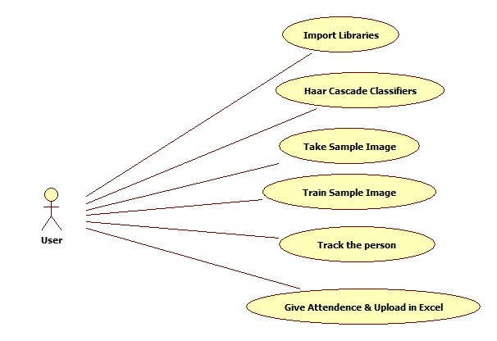
USECASE DIAGRAM

Slide 13
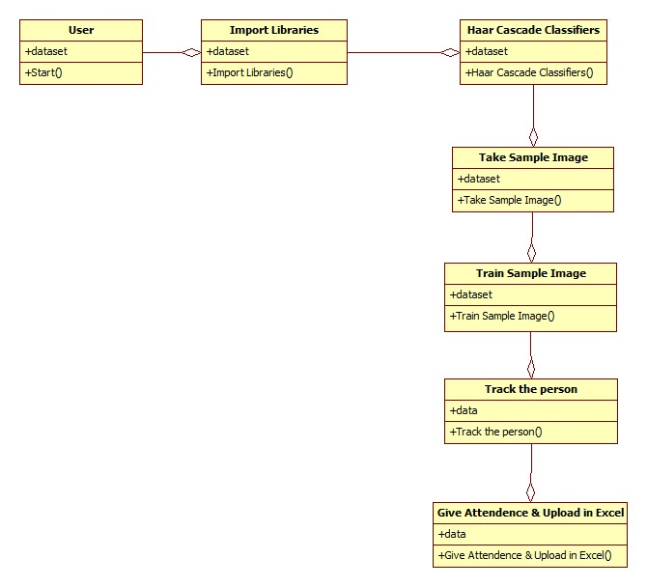
CLASS DIAGRAM

Slide 14
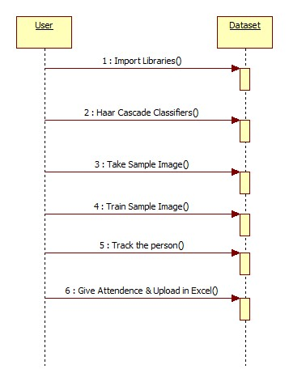
SEQUENCE DIAGRAM

Slide 15
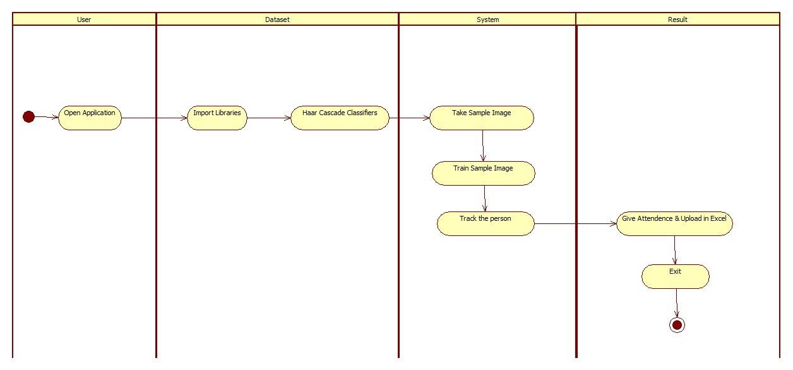
ACTIVITY DIAGRAM

Slide 16
IMPLEMENTATION

Slide 17
TECHNOLOGIES
Python:
Below are some facts about Python.
Python is currently the most widely used multi-purpose, high-level programming language.
Python allows programming in Object-Oriented and Procedural paradigms. Python programs generally are smaller than other programming languages like Java.
Programmers have to type relatively less and indentation requirement of the language, makes them readable all the time.
Python language is being used by almost all tech-giant companies like – Google, Amazon, Facebook, Instagram, Dropbox, Uber… etc.
The biggest strength of Python is huge collection of standard library which can be used for the following –
  Machine Learning
  GUI Applications (like Kivy, Tkinter, PyQt etc. )
  Web frameworks like Django (used by YouTube, Instagram, Dropbox)
  Image processing (like Opencv, Pillow)
  Web scraping (like Scrapy, BeautifulSoup, Selenium)
  Test frameworks
  Multimedia

Slide 18
PYTHON LIBARIES
NumPy: Base n-dimensional array package
SciPy: Fundamental library for scientific computing
Matplotlib: Comprehensive 2D/3D plotting
IPython: Enhanced interactive console
Sympy: Symbolic mathematics
Pandas: Data structures and analysis
Extensions or modules for SciPy care conventionally named SciKits

Slide 19
TESTING
Testing
Testing is a process of executing a program with the aim of finding error.To make our software perform well it should be error free. If testing is done successfully it will remove all the errors from the software.
Types ofTesting
      White BoxTesting
      Black BoxTesting
      Unit testing
      IntegrationTesting
      AlphaTesting
      BetaTesting
      Performance Testing and so on

Slide 20
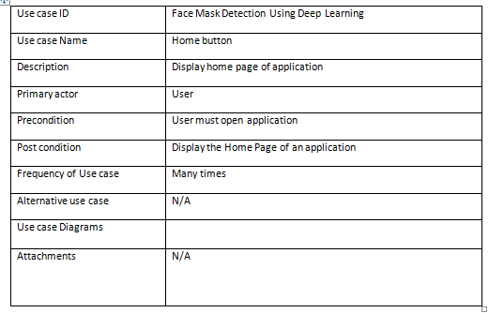
TESTCASE

Slide 21
RESULTS

Slide 22
CONCLUSION
Face detection is performed and Using the two labels which were declared one for color and the other for title, faces in the image are classified as with mask or without mask. Accuracy percentage is displayed in white color at the top of the image.

Slide 23
FUTURE ENHANCEMENTS
The present model proposed gives great accuracy for single face with and without mask.
For multiple faces also it gives quite good accuracy. It works easily on any mobile device just by switching on the video stream, with no external hardware requirement.
Further we will work for improving the accuracy for multiple face mask detection, to classify the faces into three categories that is, With mask, without mask, Improper mask instead of just the two with and without mask class by adding datasets with images of people wearing masks not covering their noses properly and also to detect the masked face using the FaceNet model of Convolutional Neural Network like in so as to further improve our model and add marking attendance feature in it by detecting the face even when the mask is on.

Slide 24
REFERENCES
[1] K. He X. Zhang S. Ren and J. Sun "Deep residual learning for image recognition" 2016 IEEE Conference on Computer Vision and Pattern Recognition (CVPR) pp. 770-778 2016.
[2 ] K. Li G. Ding and H. Wang "L-fcn: A lightweight fully convolutional network for biomedical semantic segmentation" 2018 IEEE International Conference on Bioinformatics and Biomedicine (BIBM) pp. 2363-2367 Dec 2018.
[3] S. Ge, J. Li, Q. Ye and Z. Luo, "Detecting Masked Faces in the Wild with LLE-CNNs," 2017 IEEE Conference on Computer Vision and Pattern Recognition (CVPR), Honolulu, HI, 2017, pp. 426-434, doi: 10.1109/CVPR.2017.53.

Slide 25
BIBLIOGRAPHY
Textbooks:
Programming Python, Mark Lutz
Head First Python, Paul Barry
Core Python Programming,R. Nageswara Rao
Learning with Python, Allen B. Downey
Websites:
https://www.w3schools.com/python/
https://www.tutorialspoint.com/python/index.htm
https://www.javatpoint.com/python-tutorial
https://www.learnpython.org/
https://www.pythontutorial.net/

Slide 26
THANK YOU

